Slide 1

Mathematics for Data Scientists — Esoph data set
Professeur : RACHED Imen
KIESGEN de RICHTER Stanislas
VAIO Luca

Slide 2
Presentation of the data set

Slide 3
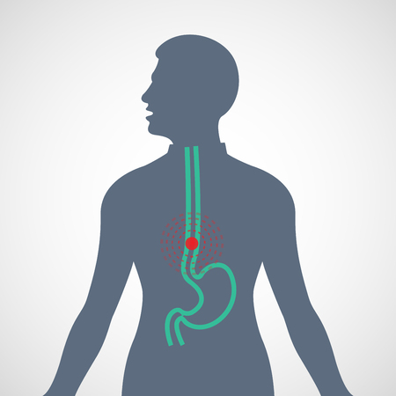
Origin of the data
Study of esophageal cancer in Ille-et-Vilaine, France.
Based on three criteria:
Age group
Tabaco consumption per day
Alcohol consumption per day
Age group | Alcohol consumption (g/day) | Tobacco consumption (g/day) | Number of cases | Number of controls
25-34 | 0-39g/day | 0-9g/day | 0 | 40
35-44 | 0-39g/day | 10-19g/day | 1 | 14
45-54 | 80-119g/day | 30+ | 2 | 4
Number of combinations: 88​
Number of persons controlled: 975 ​

Slide 4
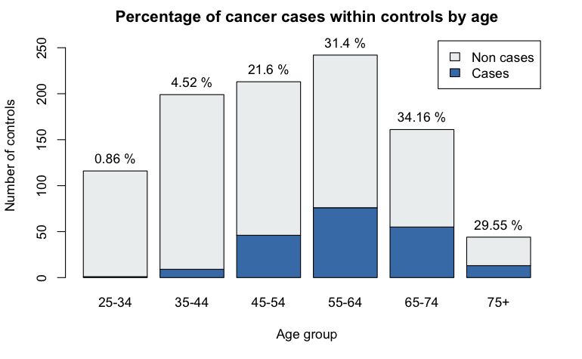
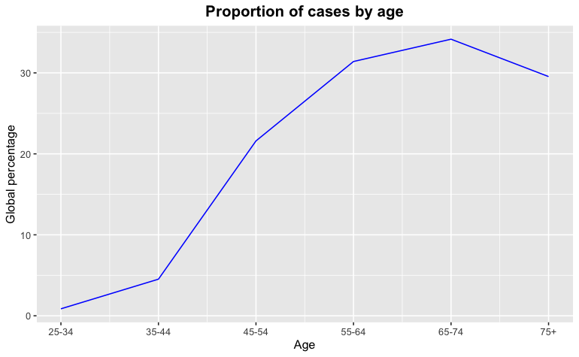
Cases per Age Group
Unequal distribution per age group
Better visualisation with a proportion graph

Slide 5
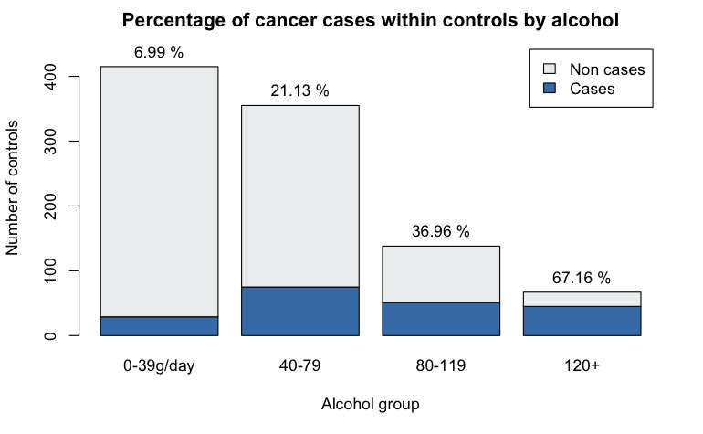
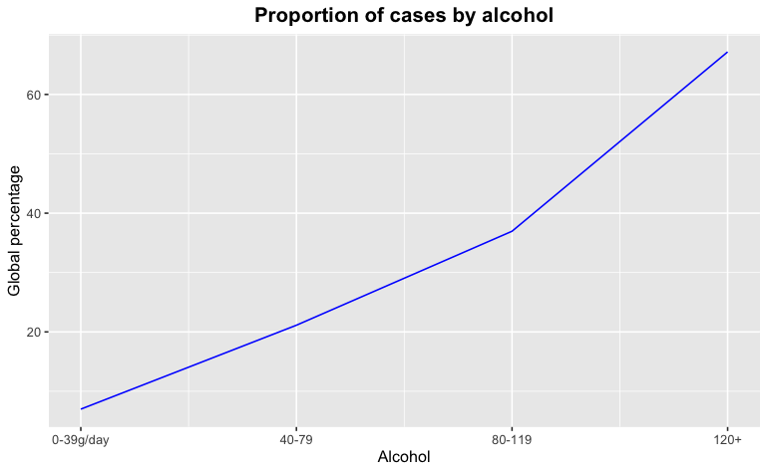
Cases per Alcohol Group
Unequal distribution per Alcohol group
Better visualisation with a proportion graph

Slide 6
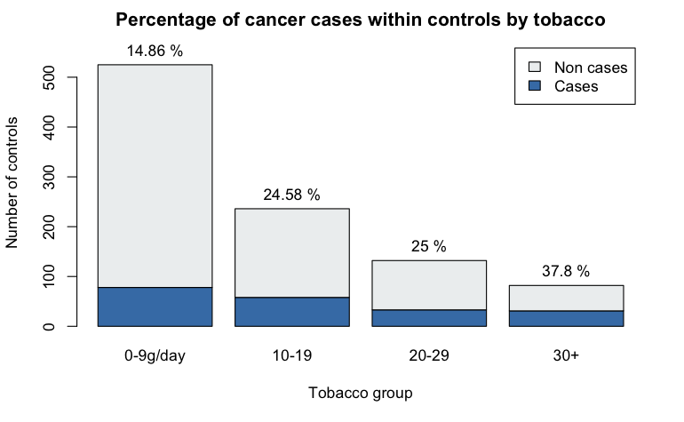
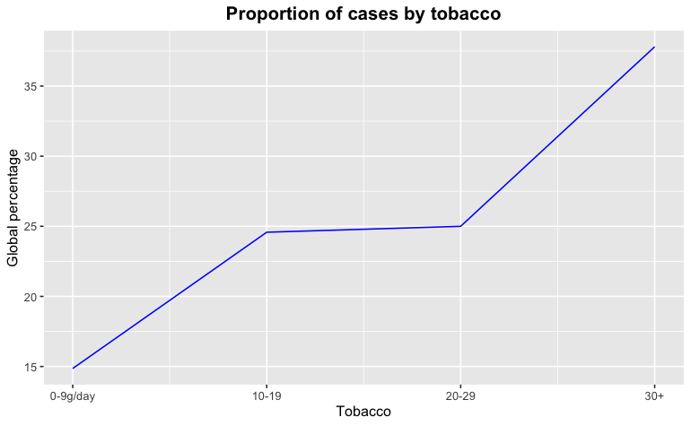
Cases per Tobacco Group
Unequal distribution per Tobacco group
Better visualisation with a proportion graph

Slide 7
Hypothesis

Slide 8
Our hypothesis
Does age favor the development of esophageal cancer ?
H₀: corr = 0, i.e. age and cases proportion are not correlated.
H_{a}: corr ≠ 0, i.e. age and cases proportion are correlated.
Does alcoholic habits favor the development of esophageal cancer ?
H₀: corr = 0, i.e. alcohol and cases proportion are not correlated.
H_{a}: corr ≠ 0, i.e. alcohol and cases proportion are correlated.
Do smoking habits favor the development of esophageal cancer ?
H₀: corr = 0, i.e. tobacco and cases proportion are not correlated.
H_{a}: corr ≠ 0, i.e. tobacco and cases proportion are correlated.

Slide 9
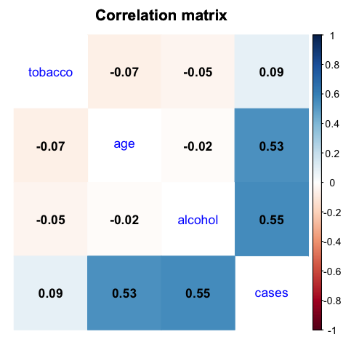
Correlation matrix
Build a clean dataset with proportions
From Pearson’s correlation matrix, the proportion of cases is highly correlated (> 0.5) to age and alcohol consumption.
Surprisingly, tobacco seems to be not correlated to the proportion of cases.
Correlation significance test:
We can reject H₀ for age and alcohol
We cannot reject H₀ for tobacco

Slide 10
Influential links of the variables on each other

Slide 11
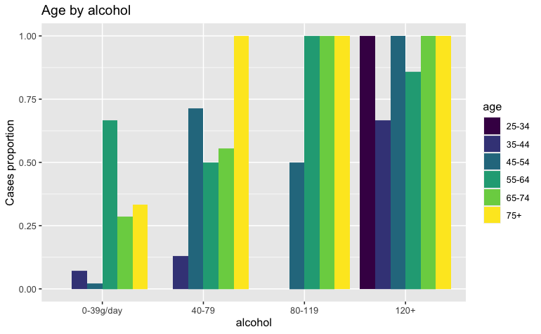
Influence of alcohol compared to age
Age as a function of alcohol consumption:
With a consumption of 40-79g of alcohol per day we have 50% or more cases, for all age categories except the first two.
With a consumption between 80-119g/day the cancer rate is 100% from the age of 55 onwards.
And almost 100% for all ages with a consumption higher than 120g/day
From this graph we can visualize quite well the impact of heavy alcohol consumption as well as the impact of age, a person consuming more than 80g is likely to have a cancer but a person under 45 is way more resistant in most cases.

Slide 12
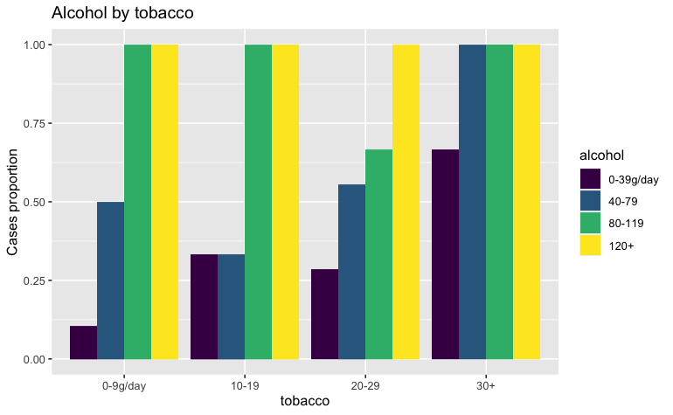
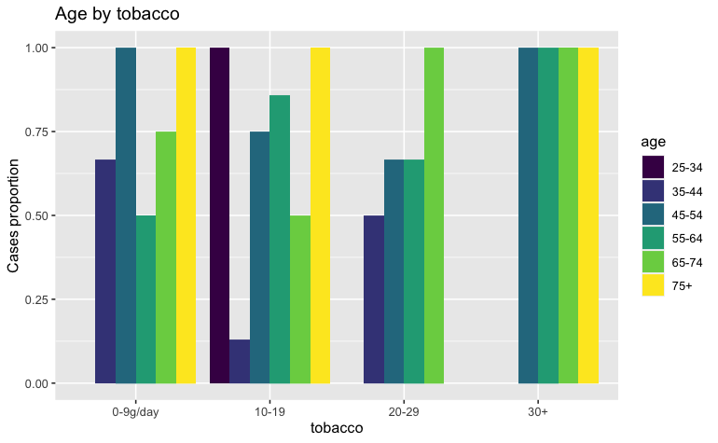
Influence of age or alcohol compared to tobacco
As far as Tobacco consumption is concerned, cancer cases are very high from the first age category onwards. Indeed, even at low doses of tobacco, and regardless of alcohol consumption or the age of the person, cases of cancer are already high.
It seems that a high consumption of tobacco combined with a moderate consumption of alcohol tends to increase cancer.
Also, certain data seem to be missing for the first age group, our population sample is probably too small to have young people smoking more than 20g/day.

Slide 13
Model building

Slide 14
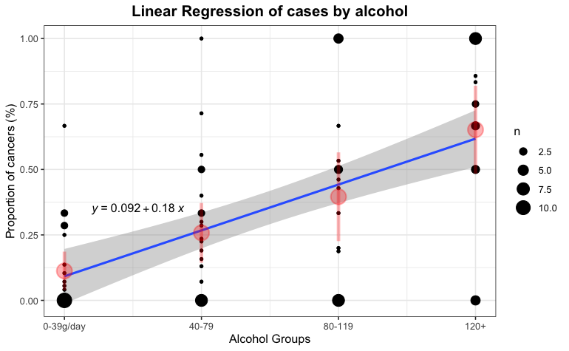
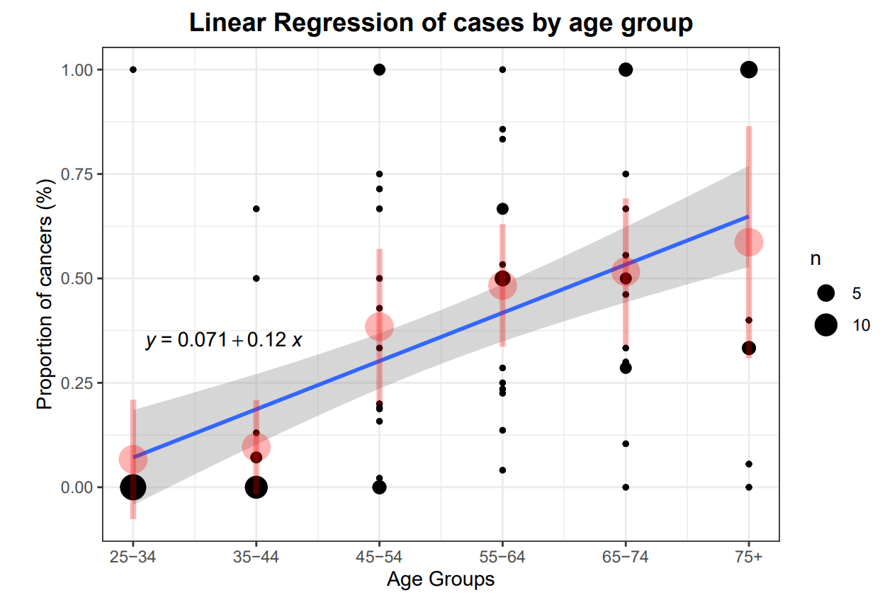
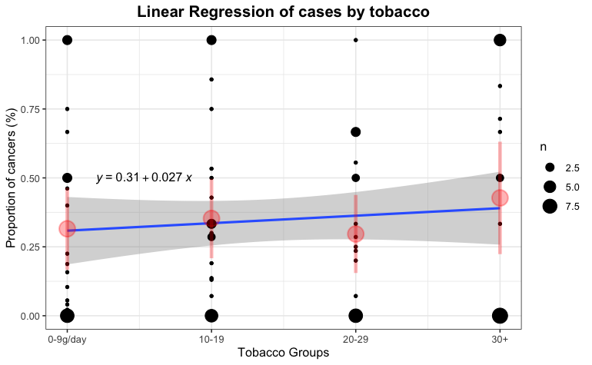
Linear Regressions
We created a linear regression model for each features (age, alcohol, tobacco).
It shows and predicts the increase of the proportion of cases when there is an increase in age or alcohol consumption.
However, the linear regression of tobacco almost predicts the stagnation of cases for all tobacco consumers.

Slide 15
Multiple linear regression
The simple linear regressions are not sufficiently accurate: R² = 0.3
Using all predictors would be better.
variables age, alcohol and tobacco are not correlated at all: they provide significantly different information for the prediction
As expected, R² = 0.6 is higher
The model could potentially predict around 60% of the values correctly

Slide 16
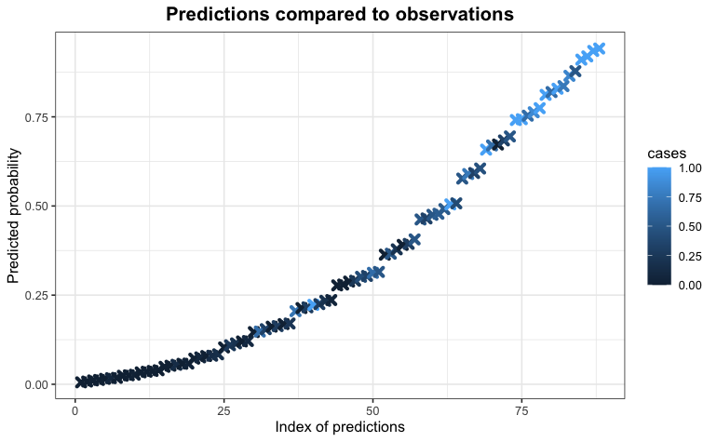
Logistic regression
R² = 0.6
P-value = 5.1 · 10⁻⁸ << 0.05
Quarters’ precision: 72 %
Young and clean: 1.1 %
Young and heavy consumer: 37.3 %
Middle: 12.2 %
Old and clean: 26.1 %
Old and heavy consumer : 95.6 %

Slide 17
Conclusion
Our dataset allows us to see a clear increase in esophageal cancer when there is:
An increase in age
An increase in alcohol consumption.
Tobacco on the other hands play a smaller role as it seems to have an impact from the beginning, someone smoking a little has almost the same chances to get a cancer as someone who smokes a lot.
Despite all that we can state that our dataset was not precise and contained a quite small amount of samples. Therefore it is possible that our analysis is flawed.
The way we created the graphs in this presentation are contained in the report as well as their explanations and interpretations, the report also contains calculus of p-values, R², residuals and much more.

